Slide 1
Static and Dynamic Routing Algorithms

Slide 2
Index
Routing Algorithm Types
Static Routing
Dynamic Routing
Distance Vector Routing
RIP v1 and V2

Slide 3
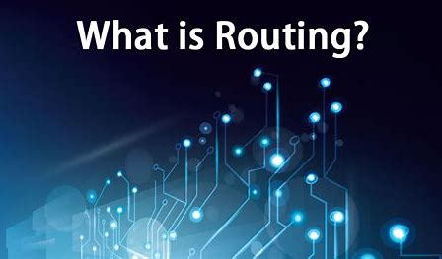
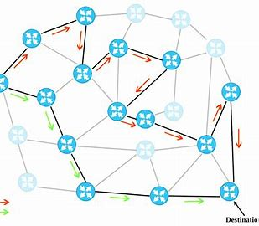
Routing
Routing: The process of selecting best path among the various options available.
It is of various types: Static, Dynamic and Default. Routers will maintain intelligence of the network topology and forward packets based on destinations, selecting the best path across that topology.
Figure: 1
Figure: 2
Figure: 3

Slide 4
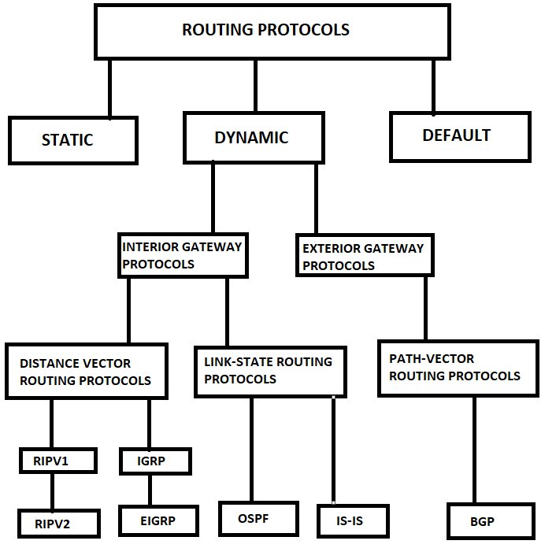
Types of Routing
Figure: 4

Slide 5
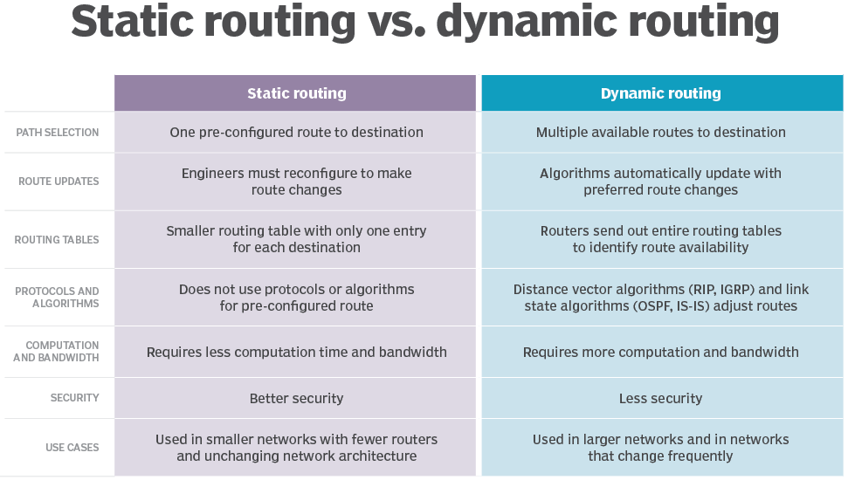
Static vs Dynamic Routing
resources credit: https://www.techtarget.com/searchnetworking/answer/Static-and-dynamic-routing

Slide 6
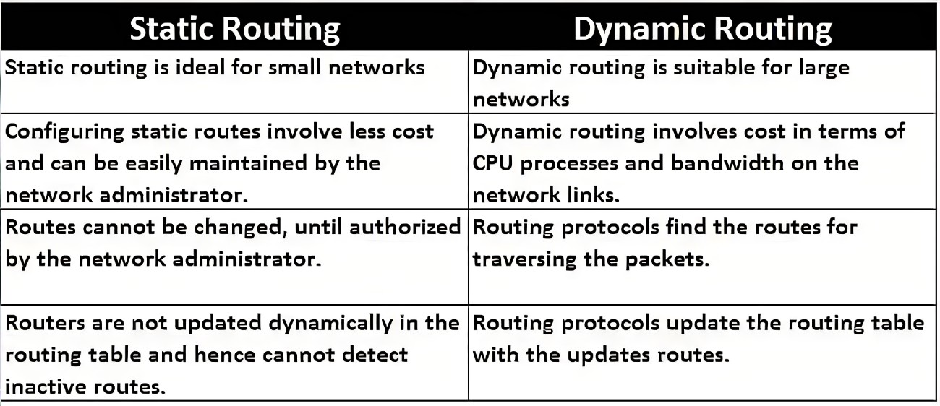
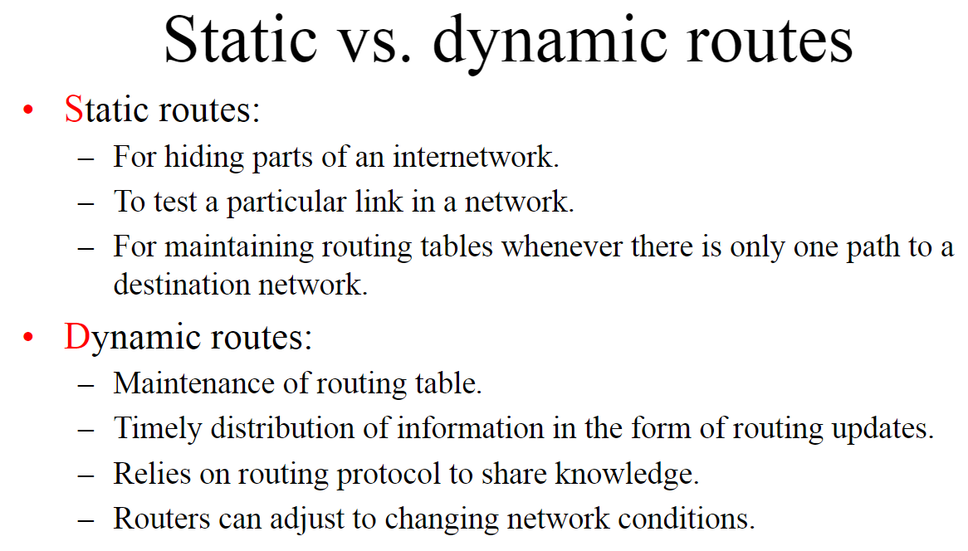
Static vs Dynamic Routing
additional resources https://www.geeksforgeeks.org/difference-between-static-and-dynamic-routing/

Slide 7
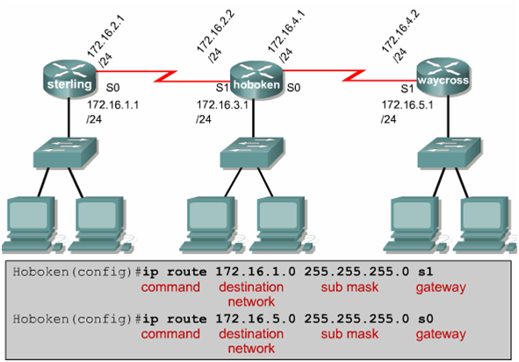
Static Routing:Configuration
Figure: 5

Slide 8
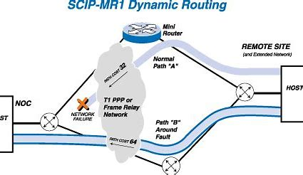
Dynamic Routing
Dynamic Routing is a network routing procedure that facilitates the routers to pick and choose the routing paths depending on the network structure’s logical changes in real-time. This is opposite to the typical traditional static network routing.
Figure: 6
Dynamic routing, sometimes called adaptive routing, is more complex than static routing because it creates more possible routes to send packets across a network. Dynamic routes are typically used in larger, fluid networks where static routes would be cumbersome to maintain and frequently reconfigure. Because dynamic routing is more complicated, it consumes more bandwidth than static routing.
.
Dynamic routing uses algorithms to compute multiple possible routes and determine the best path for traffic to travel through the network. It uses two types of complex algorithms: distance vector protocols and link state protocols.
.
Both distance vector and link state protocols create a routing table within the router that includes an entry for each possible destination of a network, group of networks or specific subnet. Each entry specifies which network connection to use to send out a received packet.

Slide 9
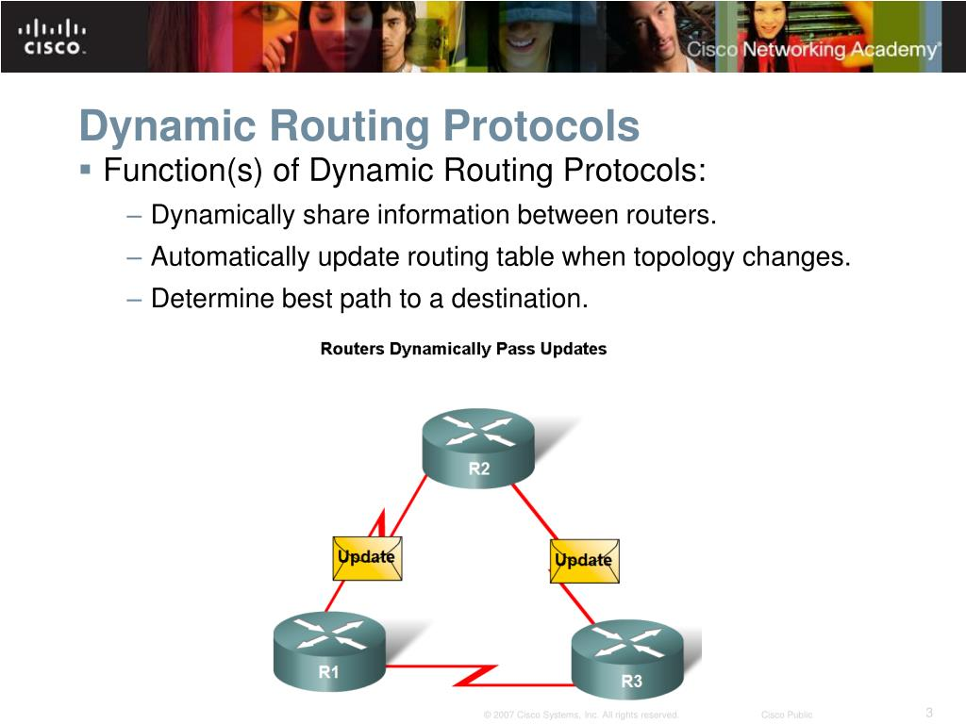
Dynamic Routing
Figure: 7

Slide 10
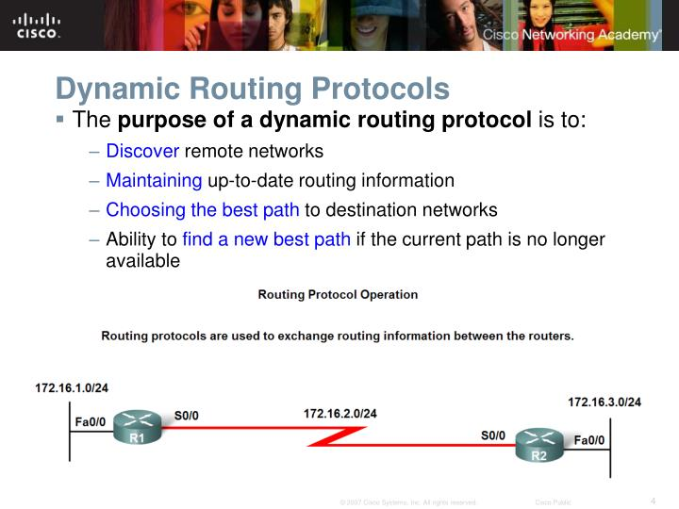
Dynamic Routing
Figure: 8

Slide 11
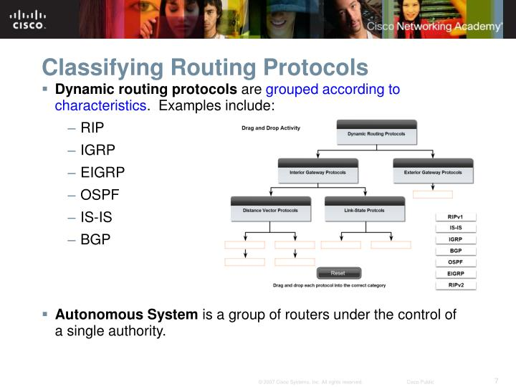
Dynamic Routing : Classifying
Figure: 9

Slide 12
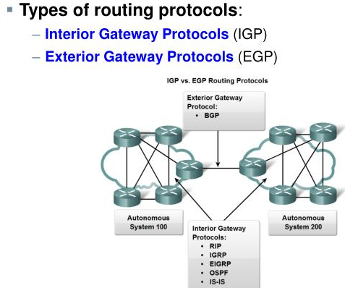
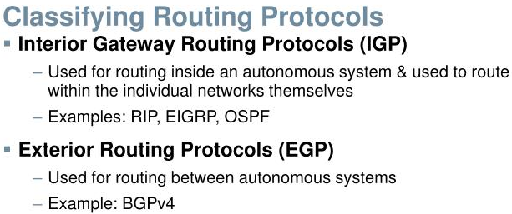
Dynamic Routing : IGP & EGP
Figure: 10

Slide 13
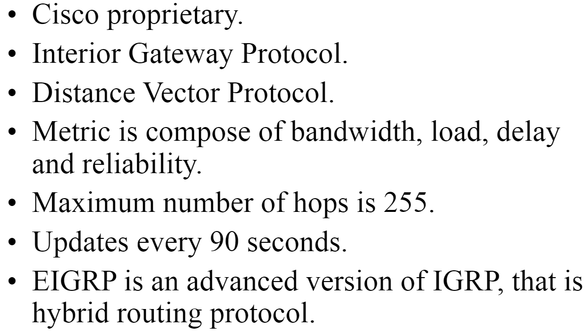
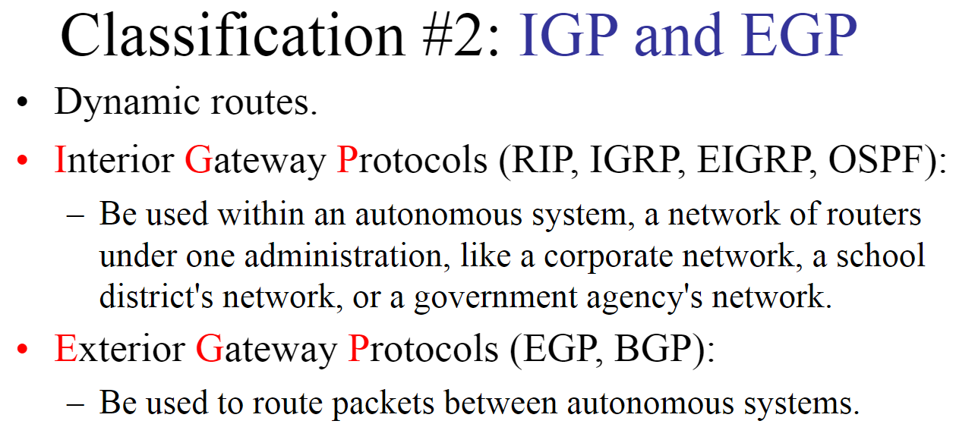
IGRP & EIGRP
resources credit: https://slideplayer.com/slide/5728088/

Slide 14
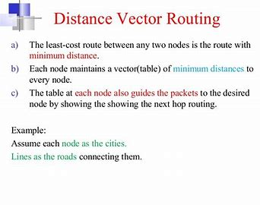
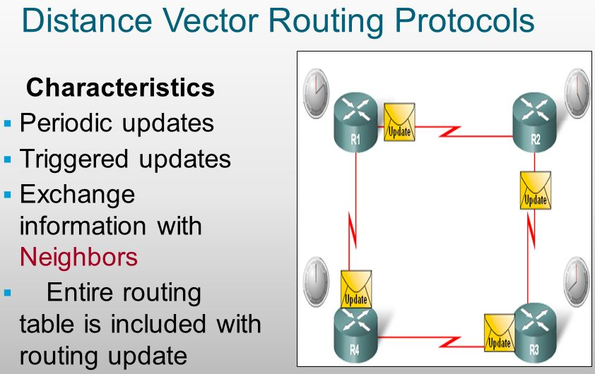
Distance Vector Routing
Figure: 11

Slide 15
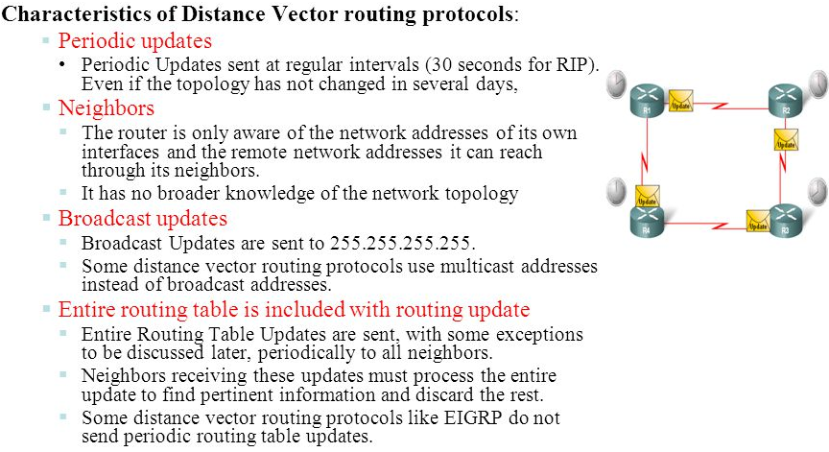
Distance Vector Routing
Figure: 12
resources credit: https://slideplayer.com/slide/5728088/

Slide 16
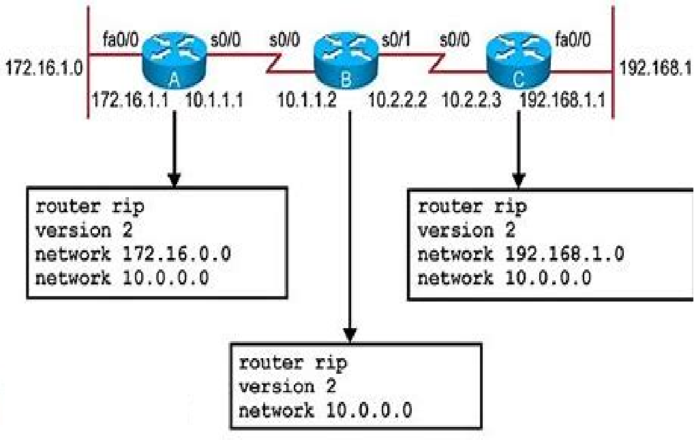
RIP:Configuration
Figure: 13

Slide 17
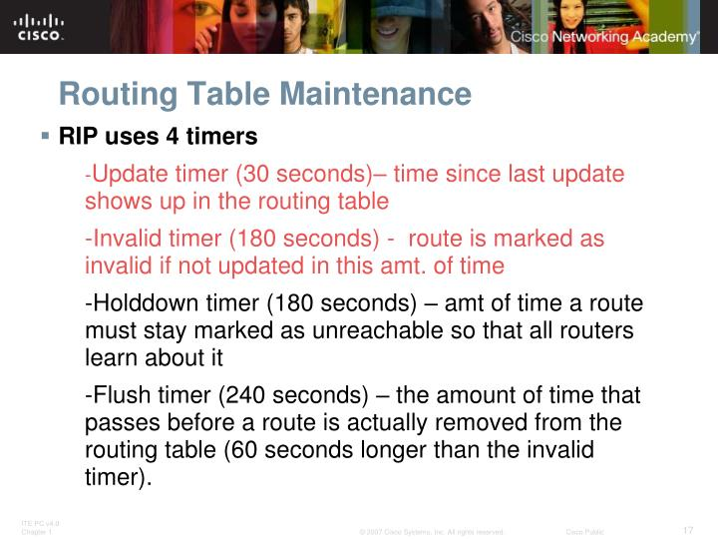
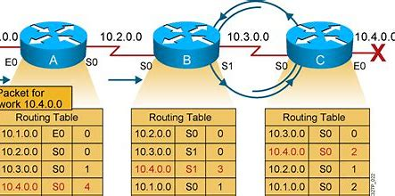
RIP:Configuration Routing Loop
Routing Table Maintenance
Figure: 14
Routing Loop

Slide 18
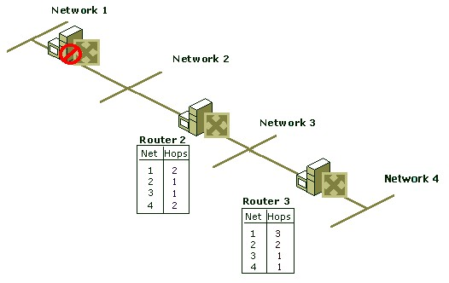
Routing Loop :Maximum Hop Count
Figure: 15

Slide 19
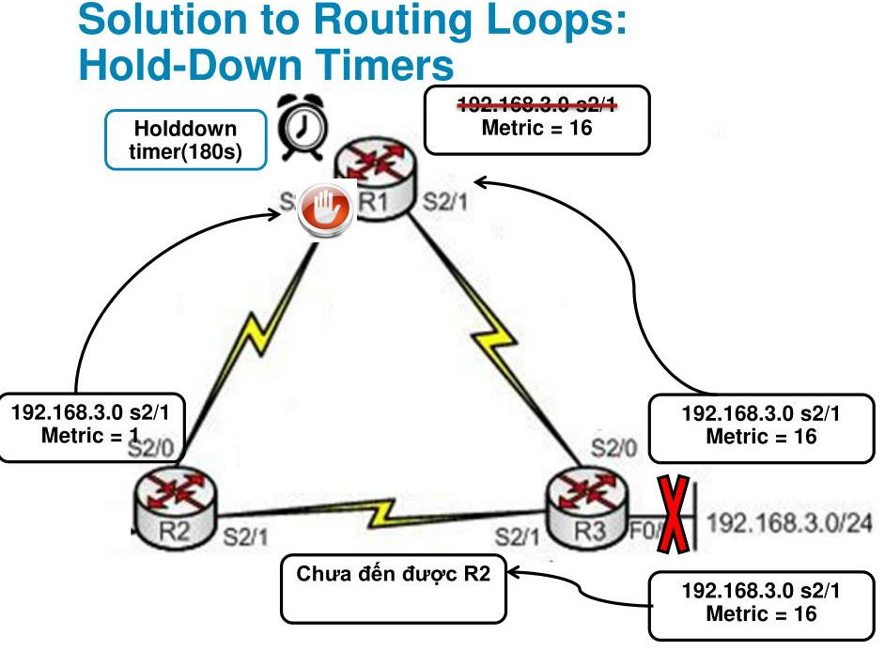
Hold-Down Timers
Figure: 16

Slide 20
Dijkstra Algorithm: Shortest path
What does it mean to be the shortest (or optimal) route?
Minimize mean packet delay
Maximize the network throughput
Minimize the number of hops along the path
Dijkstra algorithm:
Each node is labeled (in parentheses) with its distance from the source node along the best known path.
Initially, no paths are known, so all nodes are labeled with infinity.
As the algorithm proceeds and paths are found, the labels may change, reflecting better paths.
A label may be either tentative or permanent.
Initially, all labels are tentative.
When it is discovered that a label represents the shortest possible path from the source to that node, it is made permanent and never changed thereafter.
Now lets see the algorithm which describes this procedure to develop shortest path from source to destination.

Slide 21
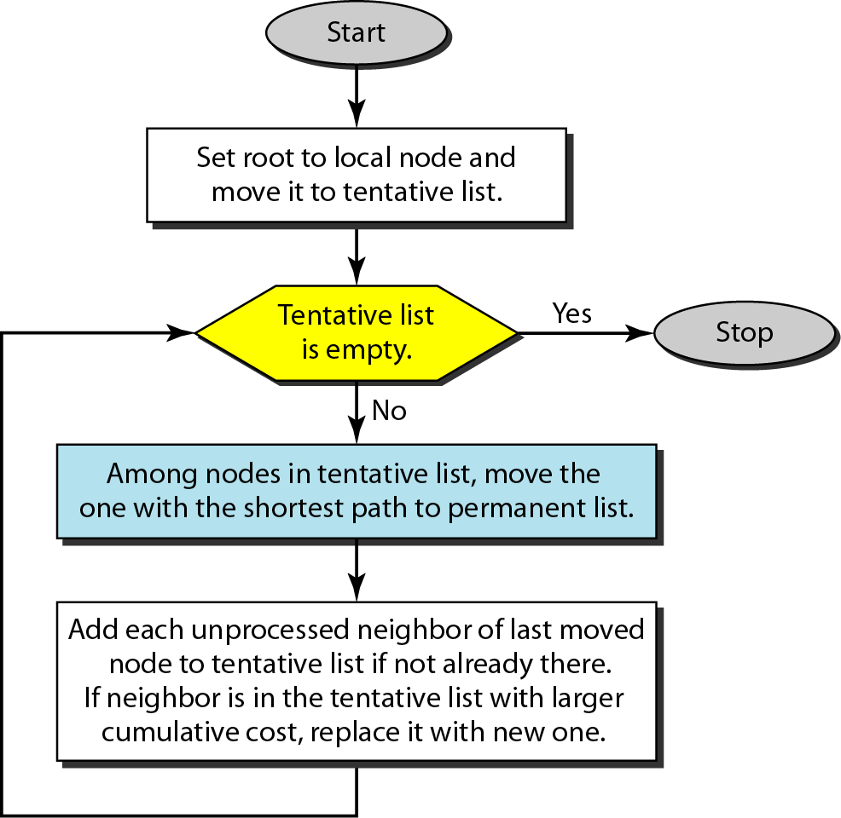
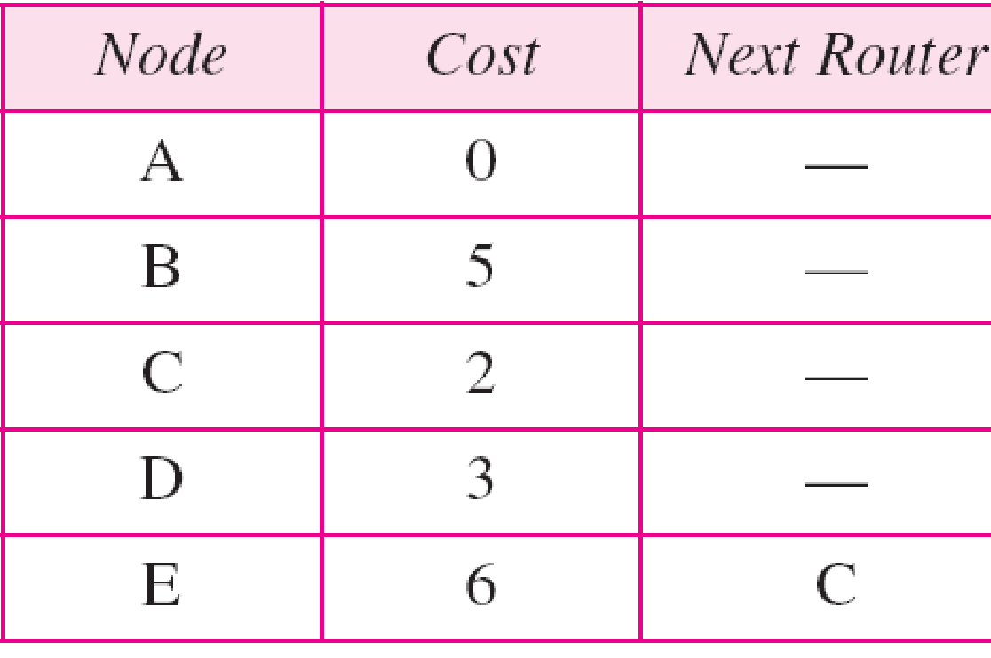
Dijkstra Algorithm
Routing table for node A
Figure: 17

Slide 22
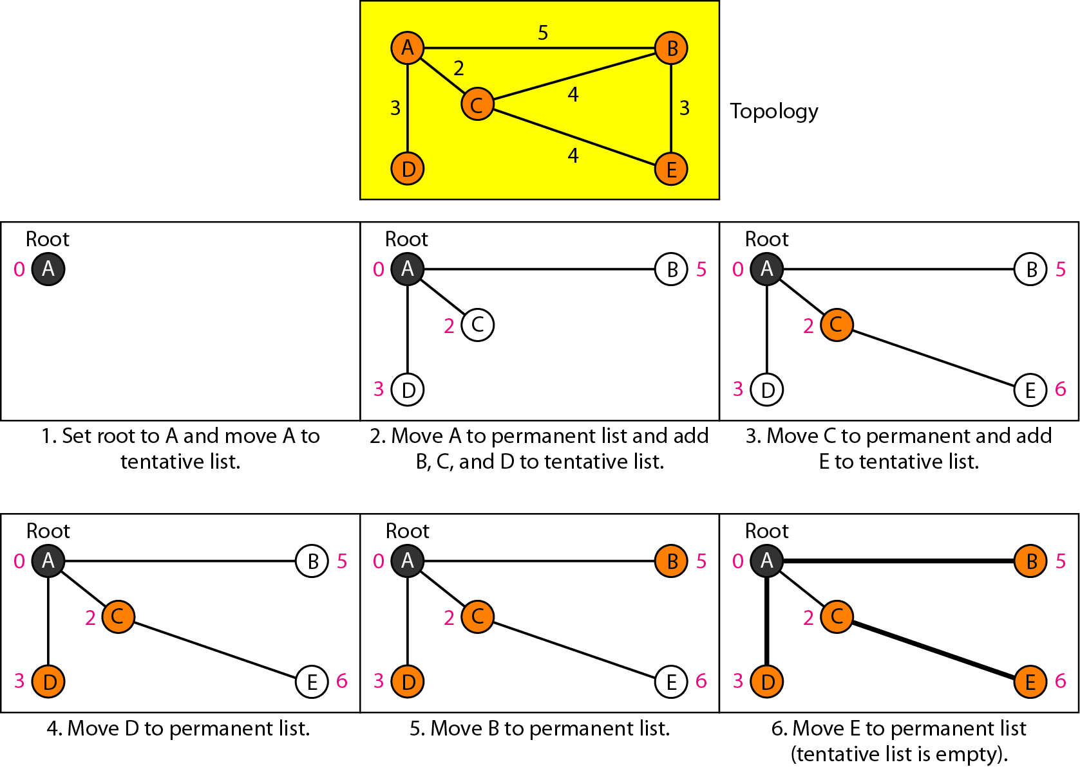
Example of formation of shortest path tree
Figure: 18

Slide 23
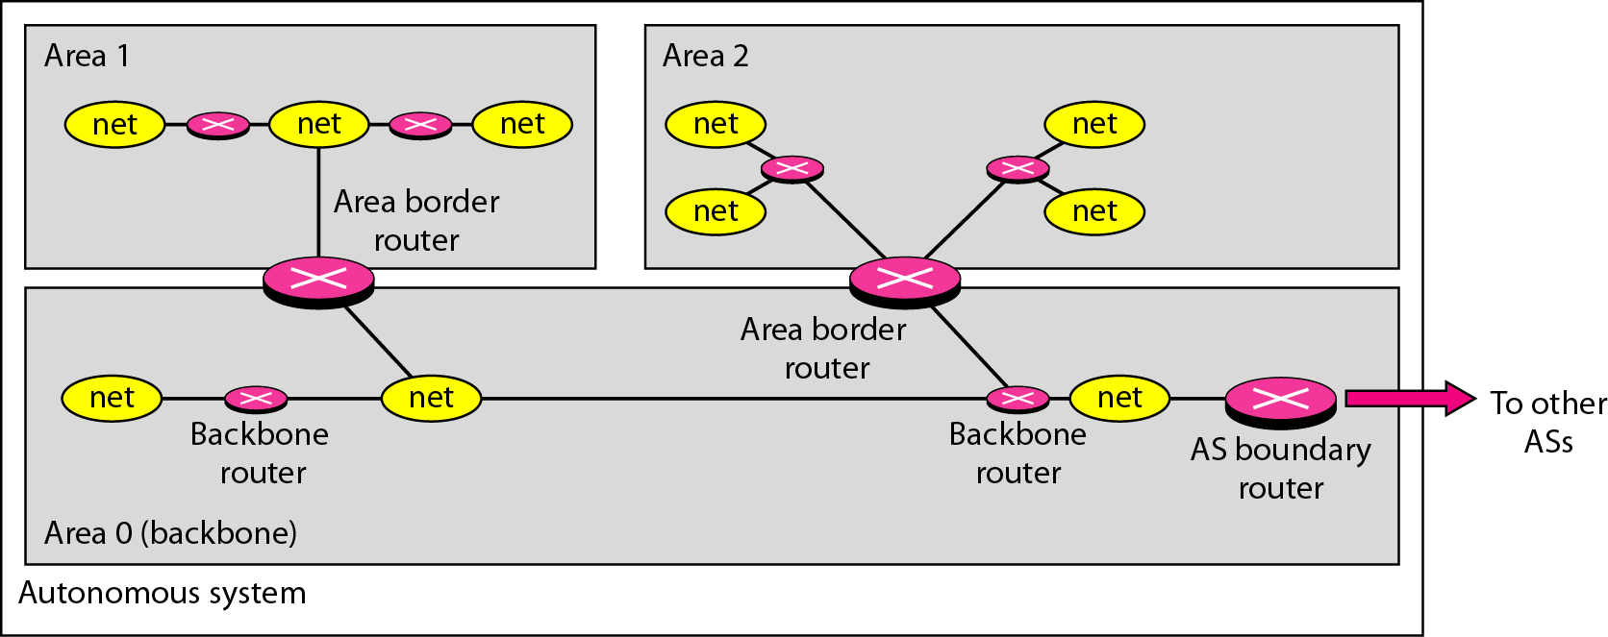
Areas in an autonomous system
Figure: 19

Slide 24
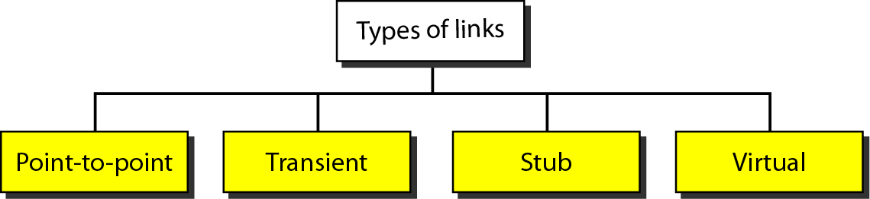
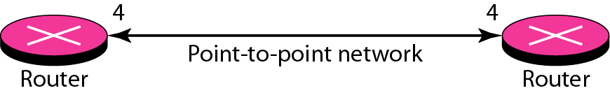
Types of links Point-to-point link
Figure: 20
Figure: 21

Slide 25
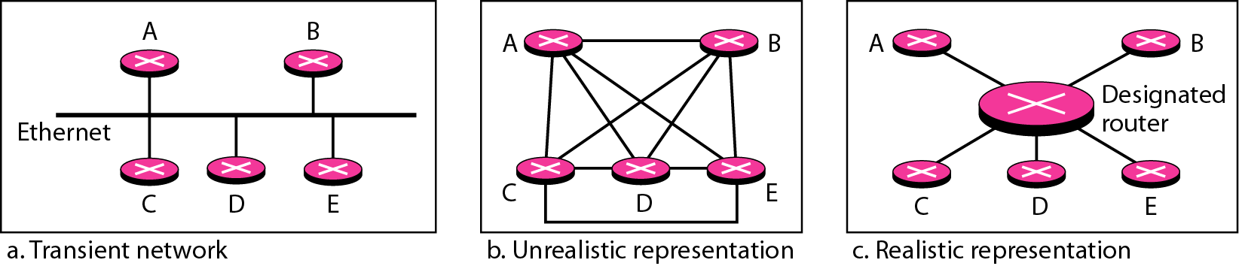
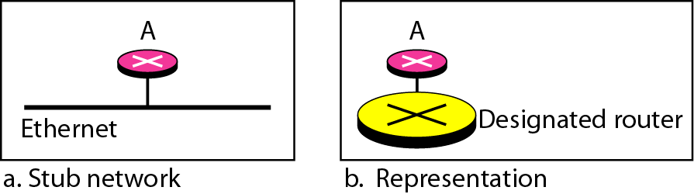
Transient link Stub link
Figure: 22
Figure: 23

Slide 26
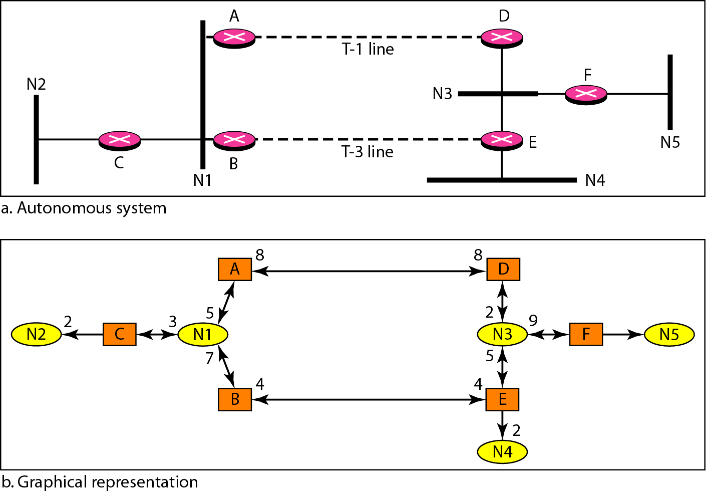
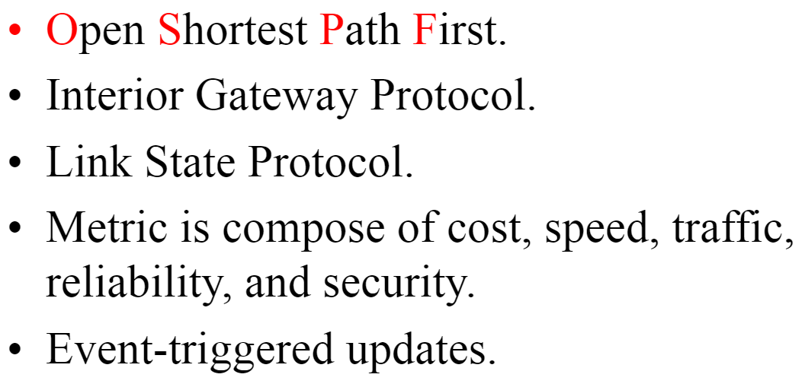
Example of an AS and its graphical representation in OSPF
Figure: 24
OSPF
Figure: 25

Slide 27
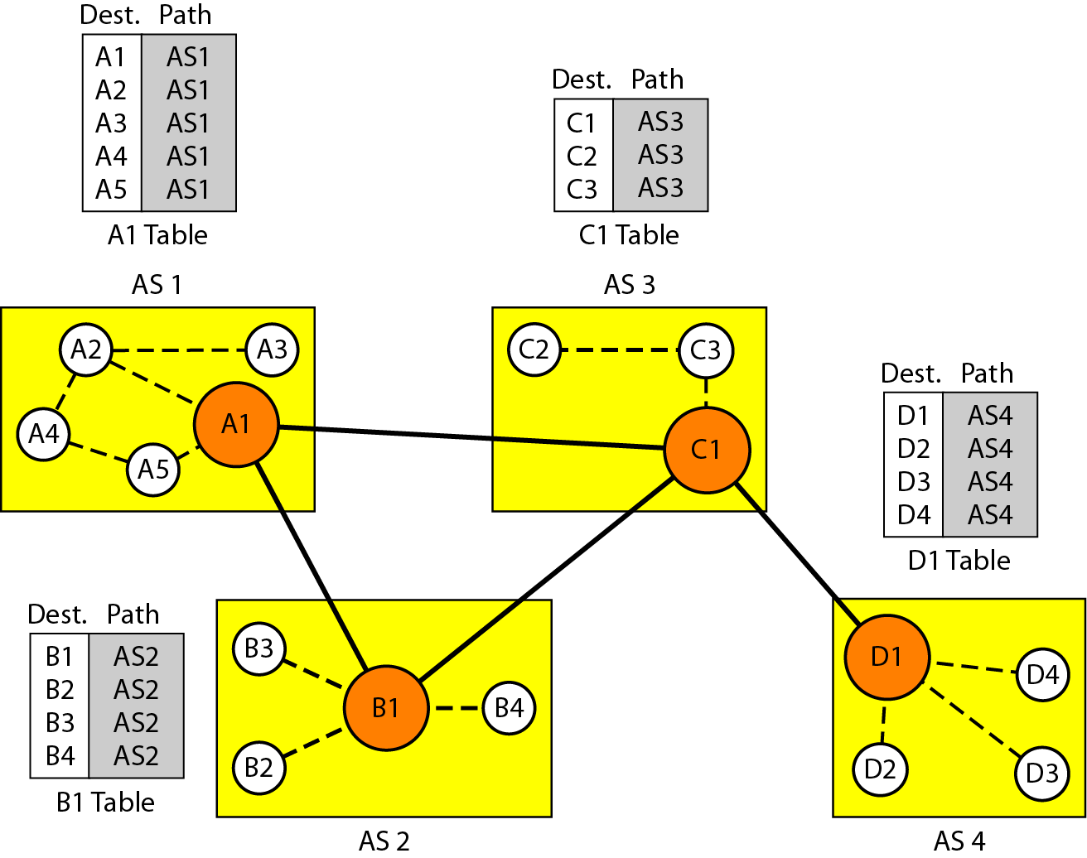
Initial routing tables in path vector routing
Figure: 26

Slide 28
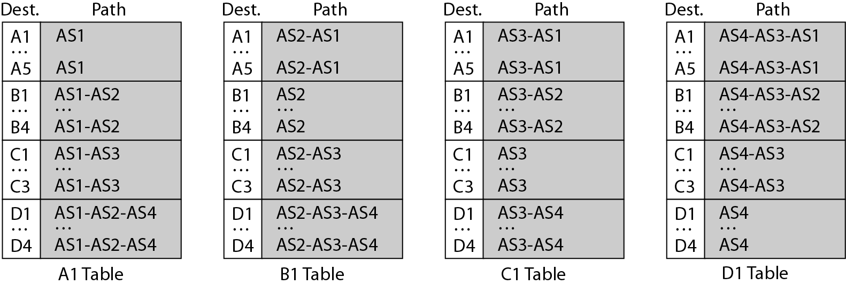
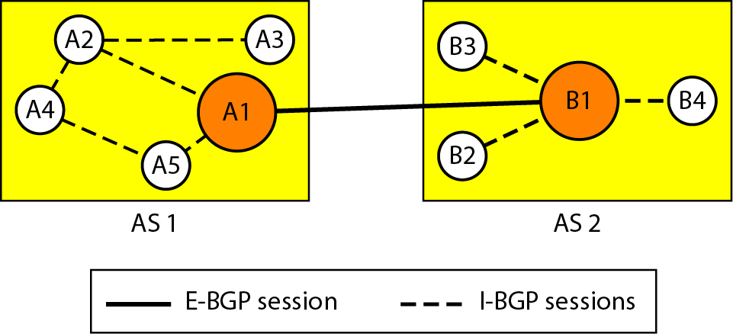
Stabilized tables for three autonomous systems
Figure: 27
Internal & external BGP sessions
Figure: 28

Slide 29
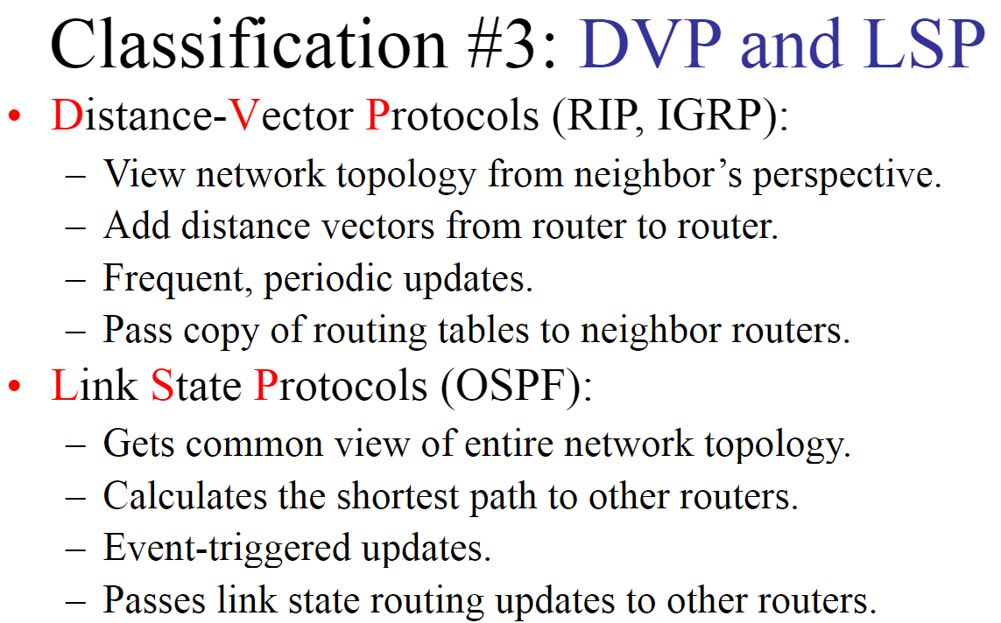
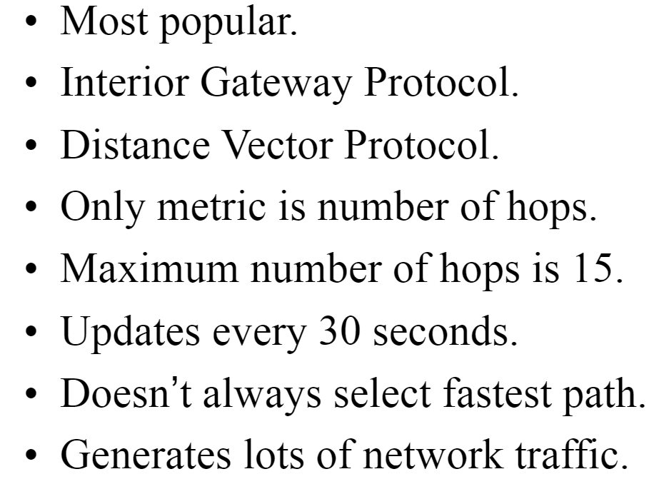
DVP (RIP) vs LSP (OSPF)
RIP
resources credit: https://slideplayer.com/slide/5728088/

Slide 30
WHAT ARE THE DIFFERENCES BETWEEN RIP VERSIONS?
resources credit: https://www.360training.com/blog/differences-rip-versions#:~:text=RIP%20v1%20is%20an%20older,MD5%20or%20plain%2Dtext).

Slide 31
RIP v1
Now let’s look at some differences between the different versions of RIP: RIP v1 uses what is known classful routing.
Classful addressing is the use of Class A, Class B, and Class C addresses. (Class D is reserved for multicasts, and Class E is reserved for future use.) Class A, B, and C addresses define a set number of binary bits for the subnet portion.
For example, a Class A network ranges from 1–127 and uses a subnet mask of 255.0.0.0.
A Class B network uses the mask 255.255.0.0, and Class C uses 255.255.255.0.
RIP v1 does not support authentication of update messages (plain-text or MD5). RIP v1 is an older, no longer much used routing protocol.
resources credit: https://www.360training.com/blog/differences-rip-versions#:~:text=RIP%20v1%20is%20an%20older,MD5%20or%20plain%2Dtext).

Slide 32
RIP v2
RIP v2 is a classless protocol and it supports classful, variable-length subnet masking (VLSM), CIDR, and route summarization.
RIPv2 supports authentication of RIPv2 update messages (MD5 or plain-text).
Authentication helps in confirming that the updates are coming from authorized sources.
It also supports multicast routing updates to reduce resource consumption (as opposed to using broadcasting in RIP v1).
RIP v2 can be useful in small, flat networks or at the edge of larger networks because of its simplicity in configuration and usage.
resources credit: https://www.360training.com/blog/differences-rip-versions#:~:text=RIP%20v1%20is%20an%20older,MD5%20or%20plain%2Dtext).

